Slide 1
Explicit Encoding of Multimodal Percepts by Single Neurons in the Human Brain
Rodrigo Quan Quiroga, Alexander Kraskov, Christof Koch, Itzhak Fried
Bioinformatics Article Explanation Presentation
http://www.cell.com/current-biology/abstract/S0960-9822(09)01377-3?_returnURL=http%3A%2F%2Flinkinghub.elsevier.com%2Fretrieve%2Fpii%2FS0960982209013773%3Fshowall%3Dtrue&cc=y=
Presented by Taiga Kuroiwa

Slide 2
Contents of this slideshow
1. background for the article
2. methods
3. Results
4. Meaning of this project
5. Problems

Slide 3
Background

Slide 4
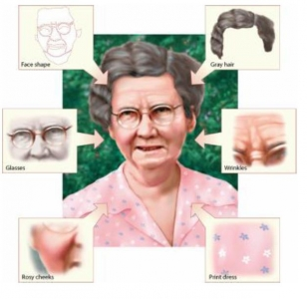
Grandmother cell
Definition – hypothetical neuron that represents complex, but specific concept of object = just a theory(kinda- outdated)
Super Direct Input – more like hardcoding
At least Monkeys have something similar = neuron fires when seeing hands and face of other monkeys = why not like bananas and genitalia?
Is it just an instinctive understanding neuron to differentiate from themselves and others?
Takes too much space in brain

Slide 5
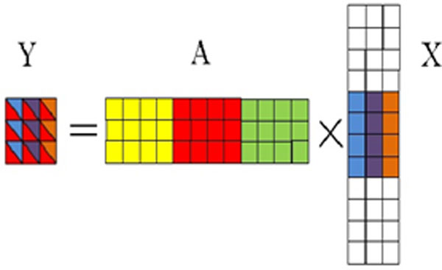
Sparse modelling
Definition – The sparse code is when each item is encoded by the strong activation of a relatively small set of neurons. For each item to be encoded, this is a different subset of all available neurons
One neuron has much more capability = brain could store much more info
Some how human brains could break down high dimensions of information into much lower stuff

Slide 6

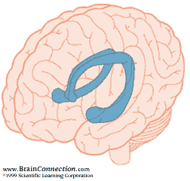
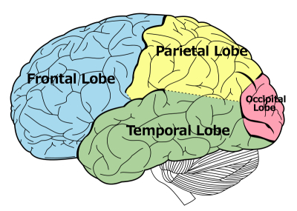
Temporal Lobe
Definition – processing sensory input into visual memory, language comprehension and emotion association
Also important for our long-term memory include hippocampus(sea horse)
Friends with Amygdala(well he is friend with mostly everybody though,,,)
I could talk about brain a lot, but lets head on

Slide 7
Methods

Slide 8
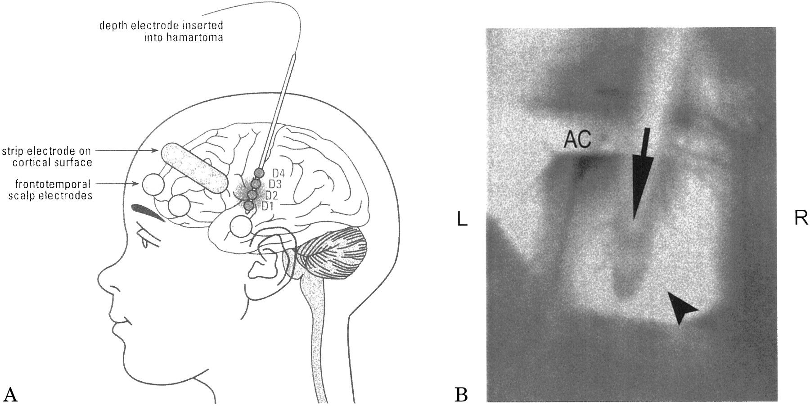
Depth electrodes
Deep deep sensor for electroencephalogram = brain electricity sensor
You don’t wanna google
7 patients, 750 units 16 sessions
Show image and text 1 sec, and sound messages varies

Slide 9
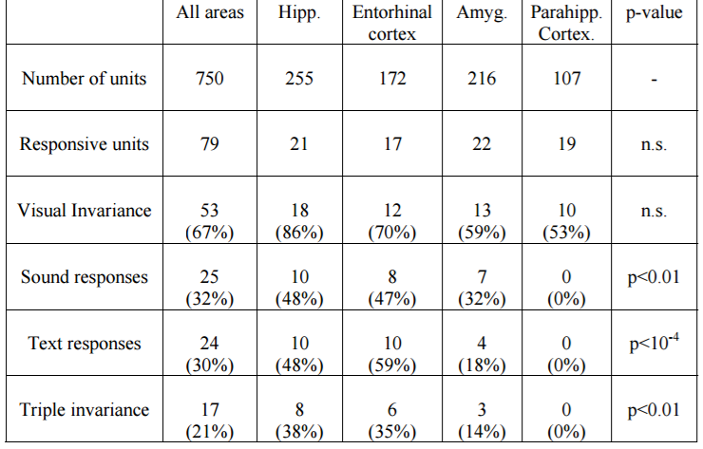
Censors on parts
1. Hippocampus
2. Amygdala
3. Entorhinal cortex (エントーライノー）
4. Para hippocampal cortex
Invariance = “we know what they are” idea = recognition
Triple Invariance is all sound, text and image responded simultaneously

Slide 10
Results

Slide 11
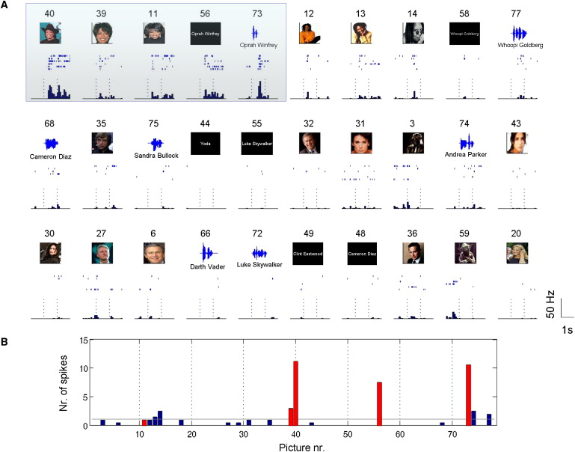
Hippocampus
1. Excessive response from Oprah Winfrey
2. Red bars are the Oprah Winfrey = cross the threshold
3. Only examples of Whoopi Goldberg
*numbers above the image is the N-th image shown to the people

Slide 12
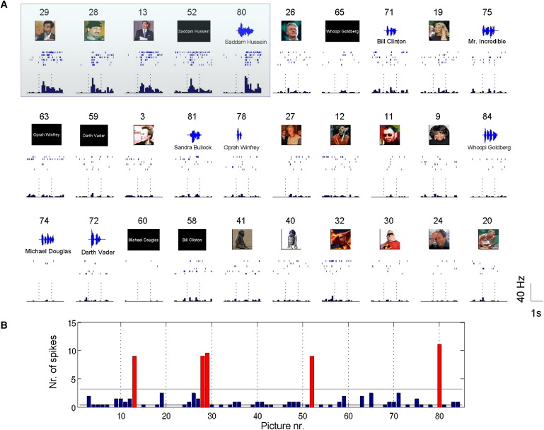
Entorhinal cortex
1. Excessive response from Saddam Hussein
2. Red bars are the Saddam Hussein= cross the threshold

Slide 13
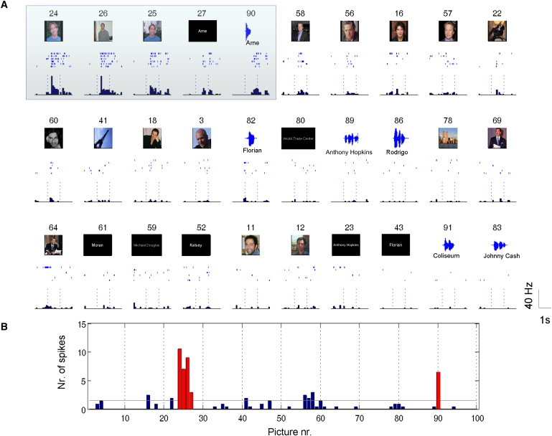
Amygdala
1. Excessive response from one of the researcher of UCLA named Arne
2. Patients never met Arne before, but can create connection to show dynamic associations within a day

Slide 14
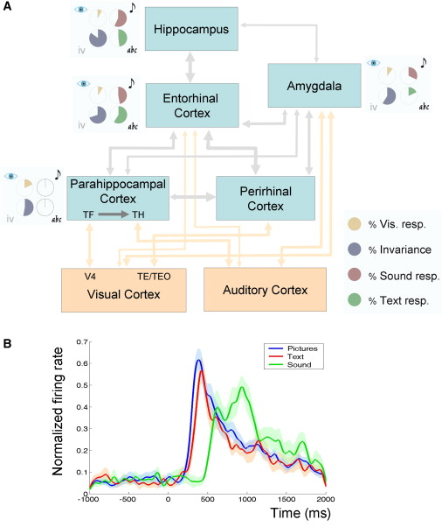
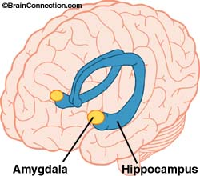
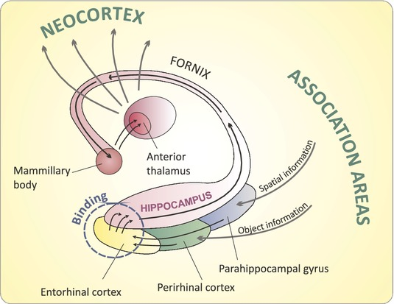
Parts of sensation processing

Slide 15
Hierarchical structure based on visual invariance
Average speed graph of 17 triple invariances --->>>>

Slide 16
Meaning

Slide 17
Convergence of information
1. convergence of different sensors
2. Neural definition of “vision” = only vision, or can text be included?
3. “ it seems reasonable to postulate that the multimodal responses described here can be created through associations, by linking faces with the written and spoken names”
4. One message = associated by different neurons = sparse coding

Slide 18
Obstacles and questions to our brain
1. Simply not enough subjects + not enough neurons covered
2. not sure how fast they could study
3. how much “understanding” will be need to recognize?
4. Why so small amount of neurons fired? = there shouldn’t be more? 79 units out of 750 units
5. possible model of both Grandmother cell and Sparse coding

